Slide 1

Lecture 3: Understanding HTTP Methods
Eng / Youssef khaled
Backend Roadmap

Slide 2

What is HTTP?
HTTP (Hypertext Transfer Protocol) is the language used by web browsers to talk to servers.
It allows browsers to request web pages from servers.
Example: When you visit a website, your browser uses HTTP.

Slide 3

HTTP Methods
HTTP methods tell the server what action to take.
There are different methods for different actions.
Common methods: GET, POST, PUT, DELETE.

Slide 4
GET Method
GET is used to request data from a server.
It retrieves information but does not change anything on the server.
Example: Loading a webpage.

Slide 5

POST Method
POST is used to send data to the server.
It is often used when submitting forms, like login forms or comments.
Example: Submitting a form to create a new account.

Slide 6
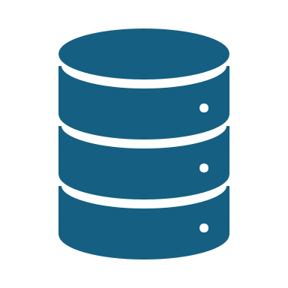
PUT Method
PUT is used to update existing data on the server.
It sends new data to replace old data.
Example: Updating your profile information.

Slide 7

DELETE Method
DELETE is used to remove data from the server.
It deletes the specified resource.
Example: Deleting a blog post or a user account.

Slide 8

HEAD Method
HEAD is similar to GET but only retrieves headers, not the content.
It's often used to check if a resource exists.
Example: Checking if an image or webpage is available.

Slide 9

PATCH Method
PATCH is used to partially update data on the server.
Unlike PUT, it does not replace all the data, only parts of it.
Example: Updating a single field in a profile.

Slide 10
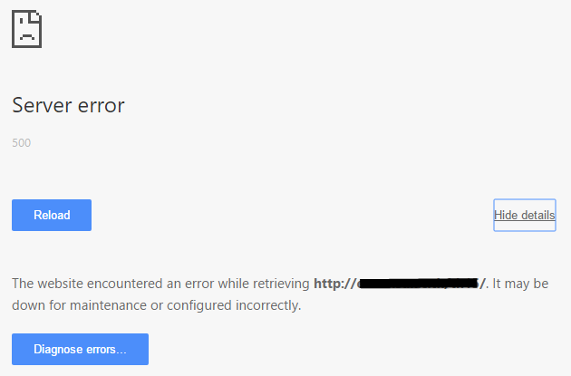
HTTP Response Codes
After using an HTTP method, the server responds with a code.
- 200: Success.
- 404: Not found.
- 500: Server error.
Example: Seeing a "404 Not Found" page when a webpage doesn't exist.

Slide 11
Summary
- HTTP methods tell the server what action to perform.
- GET retrieves data; POST sends data; PUT updates data; DELETE removes data.
- HTTP response codes show the result of your request.

